Slide 1



Zenith SIG
Emerging Technology

Slide 2
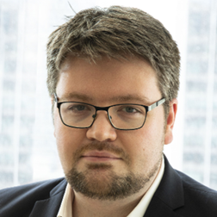


Keith O’Donnell
Zenith Founder & Co-Chair
https://www.linkedin.com/in/keithjodonnell/
keith@feynic.com

Slide 3


Primers
Brain Trust
Proofs-of-Concept
What’s Next?

Slide 4

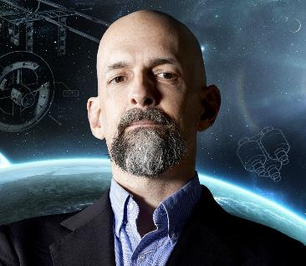

Primers
Matter Compiler Nanomachines (Zero Sum Economics – Handmade value?)
AI-Powered Primers (Adaptive Learning)

Slide 5
teaches
Basic understanding on a core subject
Adaptive open-source record
Zenith Primer
How to get started with your own experimentation
is an
teaches
In the form of
Recorded interviews, conversations, presentations, podcasts & demos
based on
A collection of documents, recordings and repositories
has integrated
Reports, whitepapers, links & insights
that encourages
Executive Briefing
allowing
this
becomes
detailing
current
Diverse & natural discourse around a topic
A historical record of progress
Future learners to understand the journey and outcomes
Technology Readiness
identifying
evaluating the
that can
become
Blockers to readiness
Industry Landscape
Development of content for learning management platforms or higher education
Training Primers
through
Opportunity, impact, feasibility and future analysis
through

Slide 6
TLDR;
Teaches Basic Understanding
Open-Sourced Executive Briefing Detailing Tech Readiness & Industry Landscape Listing opportunities and blockers
Multimedia Collection Interviews, podcasts & demos Reports, Whitepapers, Links & Insights

Slide 7


Theory
Technical
Commercial

Slide 8





Education & Training
Body of Work
Skills & Awards
Professionalism & Ethics
Continual Development

Slide 9
Education & Training
Do you have relevant education or prior training or experience?

Slide 10
Body of Work
Can you demonstrate any projects, recordings or other material?

Slide 11
Skills & Awards
Have you received any notable accreditation or awards?

Slide 12
Professionalism & Ethics
Putting the trust in Brain Trust

Slide 13
Continual Development
Are you committed to the never-ending pursuit of knowledge?

Slide 14
Initial Technologies
Artificial Intelligence | 4D Printing
Blockchain & DLT | Biotechnology
IOT, 5G & 6G | Regulatory Technology
Robotics & RPA | Next-Gen Materials
Spatial Computing | Natural Language Processing
Quantum Technology | Advanced Data Processing
Neural Interfacing | Cloud Computing
Space Technology | Crypto Agility

Slide 15


Slide 16








Identify
Barrier
Call to
Action
Expert
Vetting
Value
Proposition
Funding
Develop
Project
Showcase
Source Release & Maintenance

Slide 17
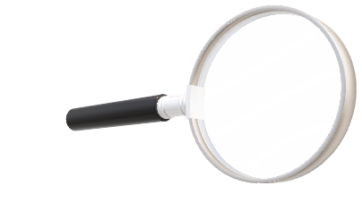
Zenith
FINOS Labs
FINOS

Slide 18
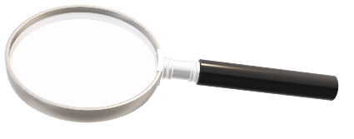
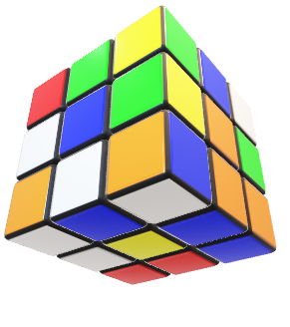
Zenith
FINOS Labs
FINOS

Slide 19
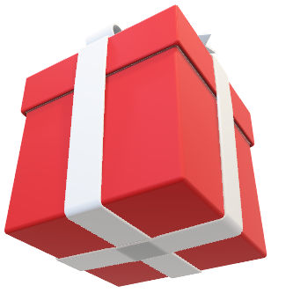
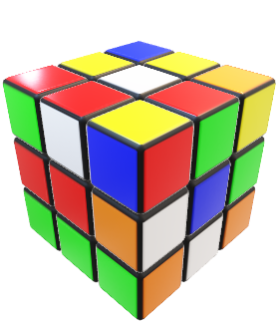
Zenith
FINOS Labs
FINOS

Slide 20
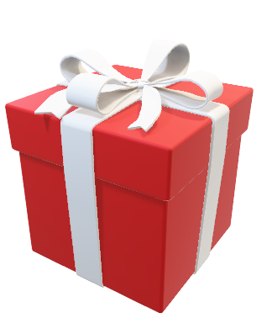
Zenith
FINOS Labs
FINOS

Slide 21










https://www.apache.org/licenses/LICENSE-2.0
Linking licensed code to code under a different license
Distribution of code to third parties
Modification of code
Protection of licensees & contributors from patent claims
Private use or internal use by a company
Sublicensing of modified code under a different license
Use of trademarks associated
licensed code or its
contributors by a licensee

Slide 22

Photo by Ian Schneider

Slide 23
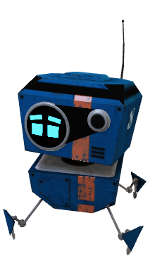

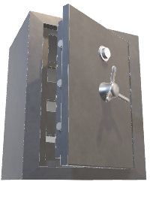

Slide 24
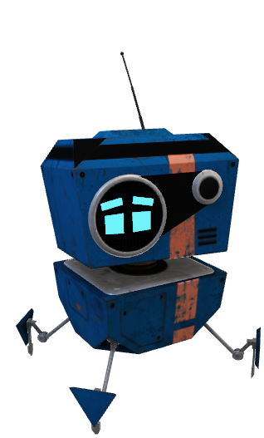


Robotic Process
Robotic Process & Automation
Automate repetitive tasks
Reduce costs & improve efficiency
Used in Customer Support, Data Entry & Compliance Monitoring

Slide 25
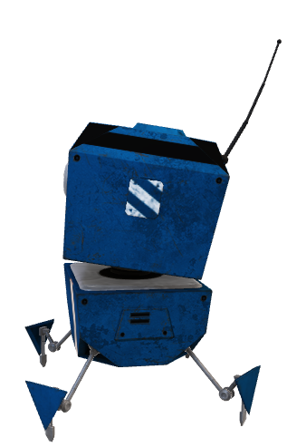

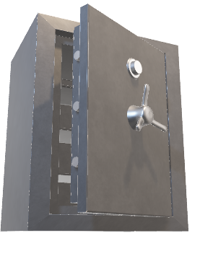
Crypto Agility
Crypto Agility
Quickly adapt to evolving encryption requirements
Ensure security & trust while maintaining resiliency to advanced threats

Slide 26



Natural Language
Natural Language Processing
Understand & interpret human language
Give additional insights or augment workers through simple automations
Users in sentiment analysis & improving customer interactions

Slide 27


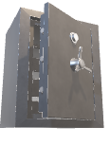

Natural Language
Combination of all three
RPA + Crypto Agility + NLP
New Standards Published (NLP + Crypto Agility)
Dependent Libraries Flagged (RPA + NLP)
Policies automatically applied (RPA + Crypto Agility)

Slide 28
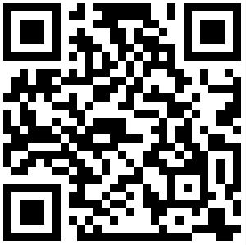


Thank you
Find out more at
zenith.finos.org

